Slide 1
Impact of frequency of floodings on plant populations
A theoretical model as part of the 2024 THEE research practical
Ramin Dürst & Matthias Schönholzer

Slide 2
Context
THEE research practical
Expanding R-code for evolutionary rescue
Biological scenario with hypothesis and relevance
Generating and plotting data
Interpreting plots and linking them to biological scenario
Notes:
Both bachelor students
R-code was provided
Simple evolutionary rescue

Slide 3
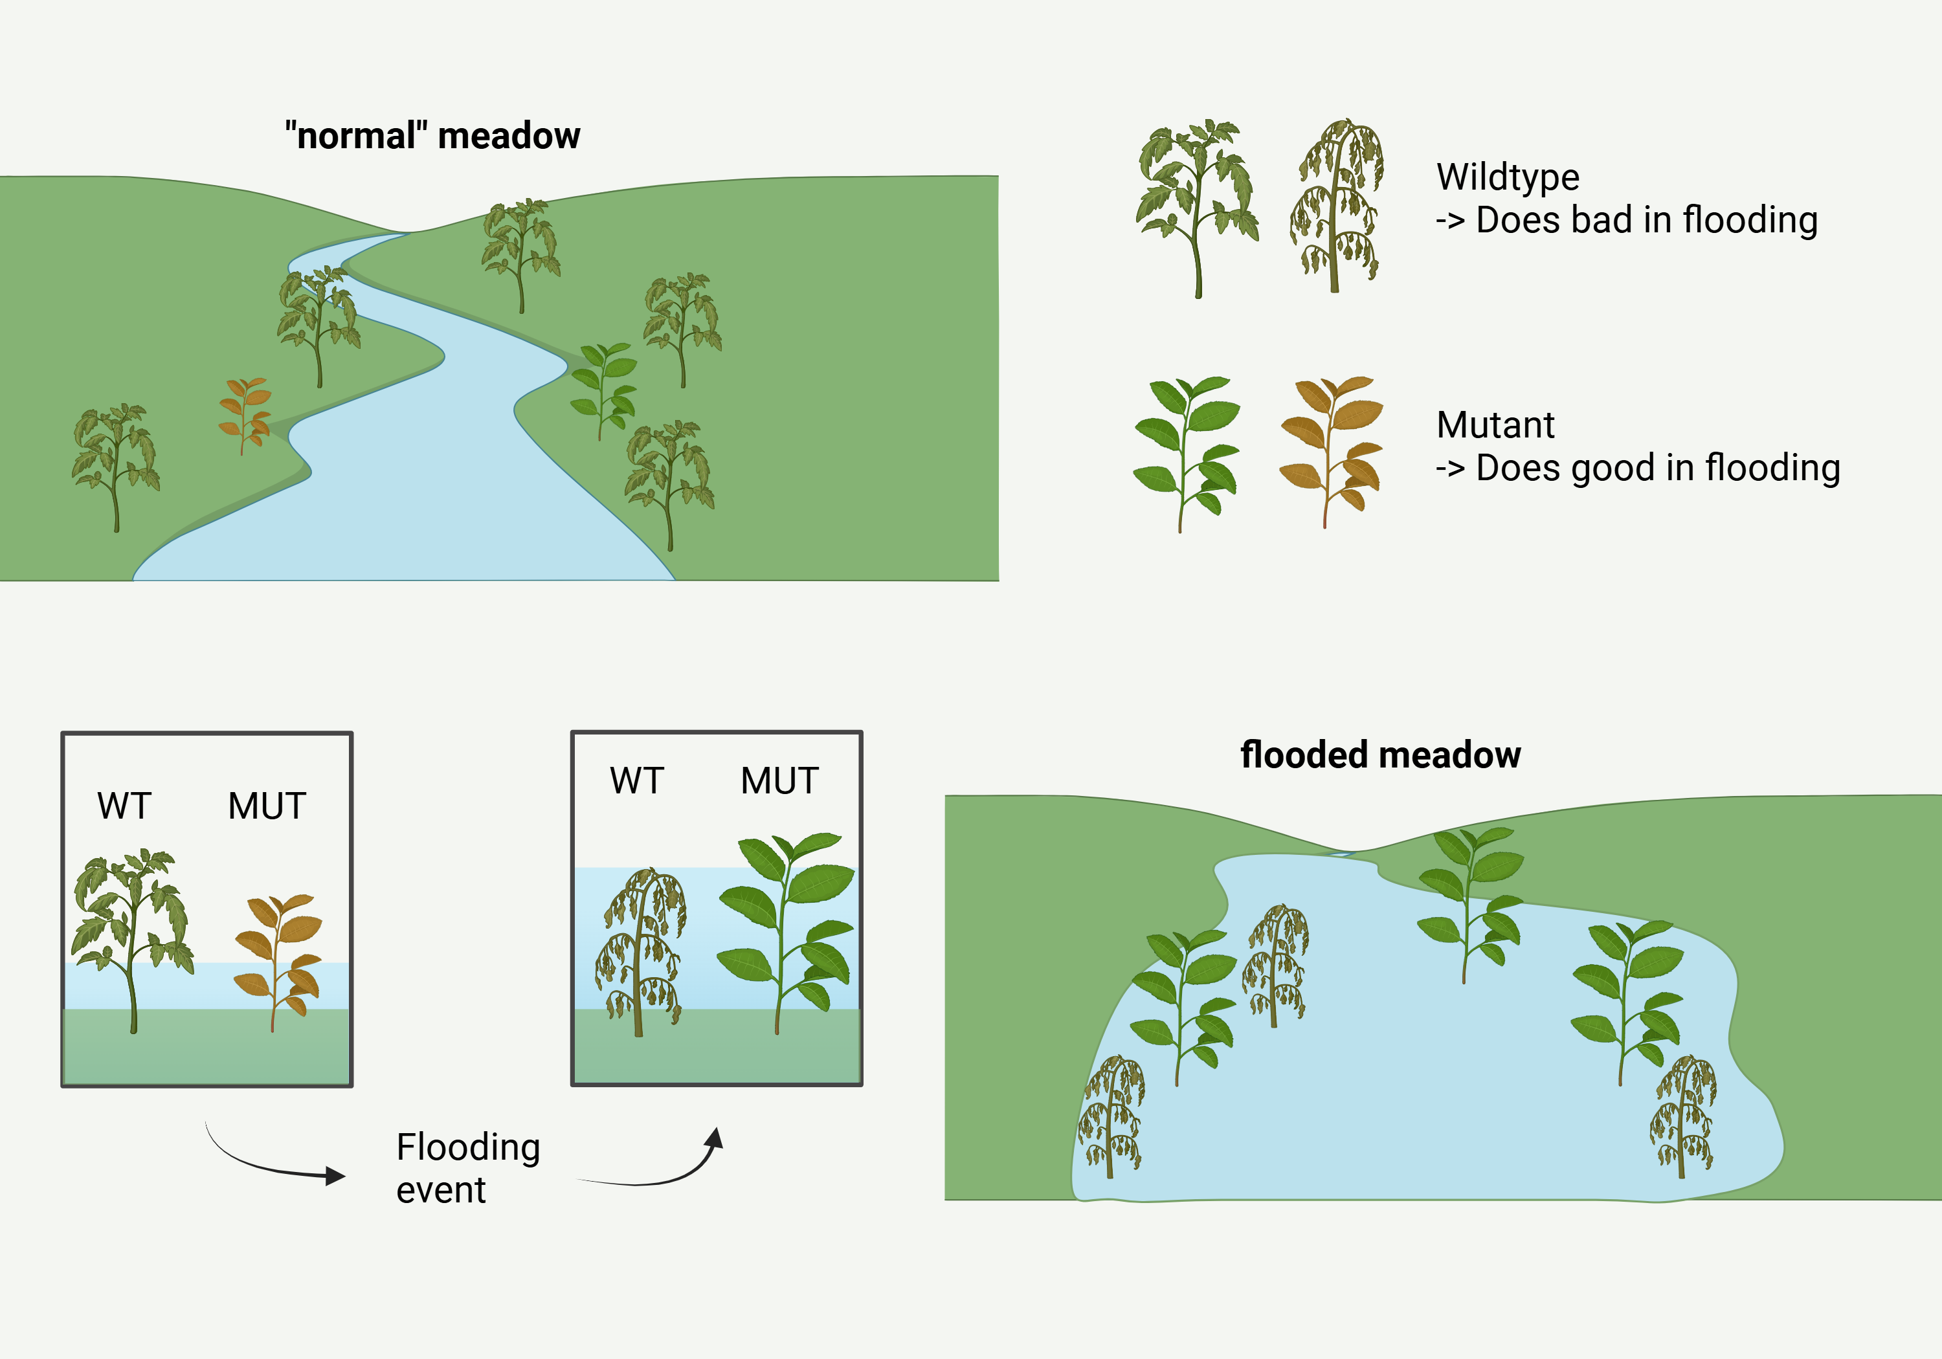
Biological Question
Effect of flooding frequency on…
Population composition?
Extinction rate?
Notes:
River meadow, floods regularly
Focus on plant population with 2 Genotypes,
Pause between flooding events determines the frequency
“And we want to see how this frequency effects…”

Slide 4
Biological scenario
Increasing frequency of floodings due to climate change
Chance for “Evolutionary rescue” by beneficial mutation
Maintaining the species
Hypothesis:
With low frequencies of floods, the wildtype population has a higher chance to persist.
The higher frequencies of floods, the more likely the mutation takes over.
Notes:
Relevancy because of climate change, increases frequency & intensity of floods, that why we focus on frequency
Beneficial mutation:
- longer stems
- more aerenchym to store oxygen more efficient
- any physiological / morphological trait that leads to benefits in flooded areas

Slide 5
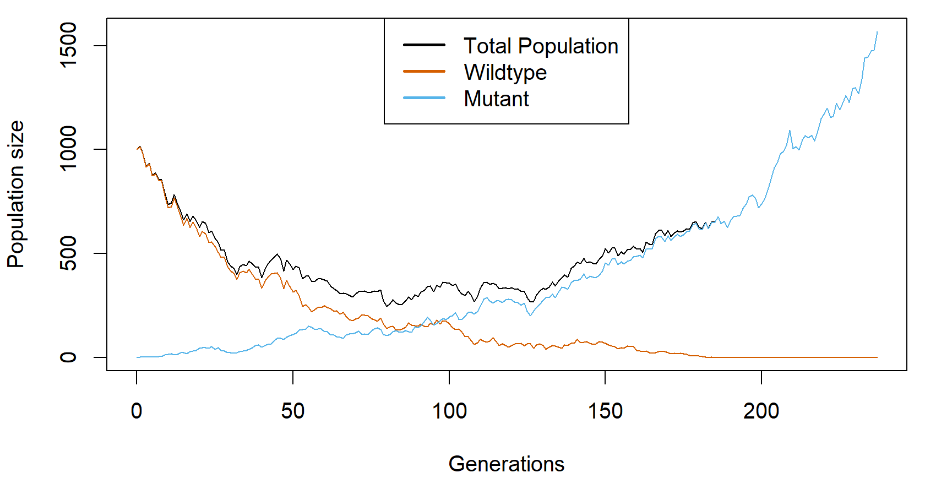
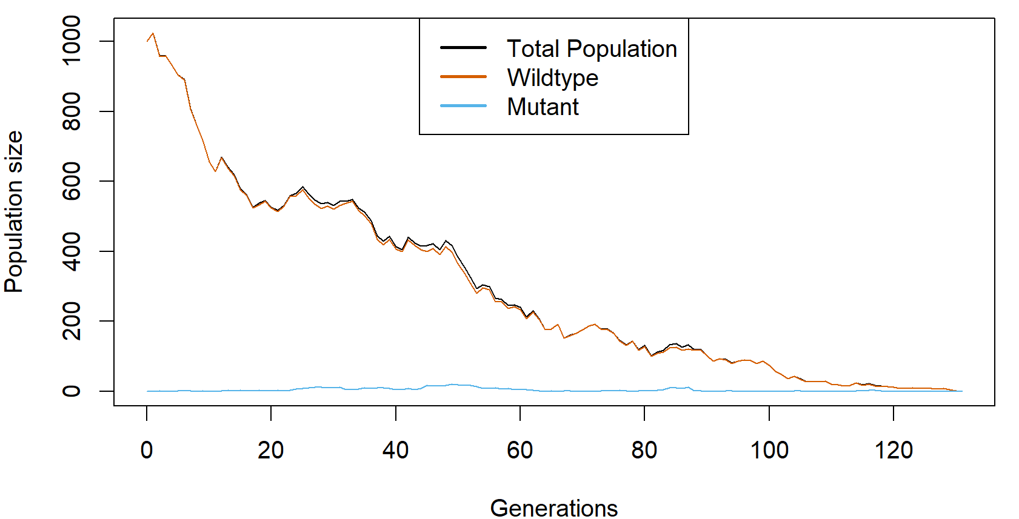
Evolutionary rescue
Population faces extinction, due to a changing environment
Can be saved by a genetic adaptation
In our case:
Wildtype population struggles with high frequency of floodings
Flood-adapted mutation might save population by taking over
Notes:
Plots are from one simulation with event-duration = 5 generation
Due to stochasticity can go extinct or not
Generations as a measure of time

Slide 6
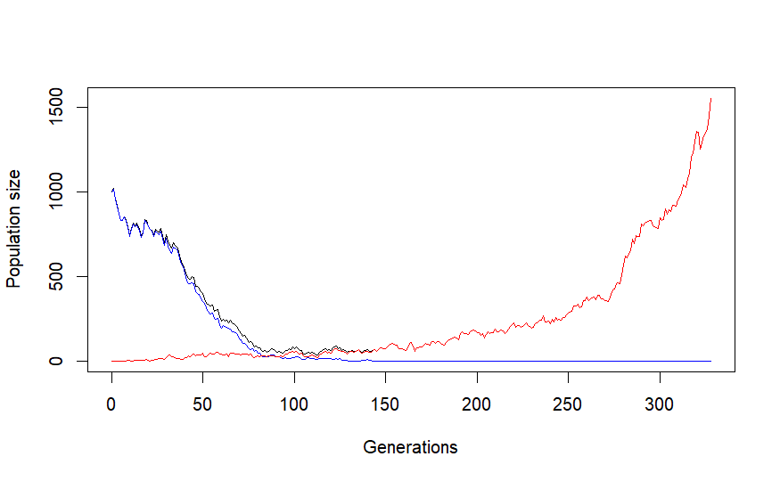
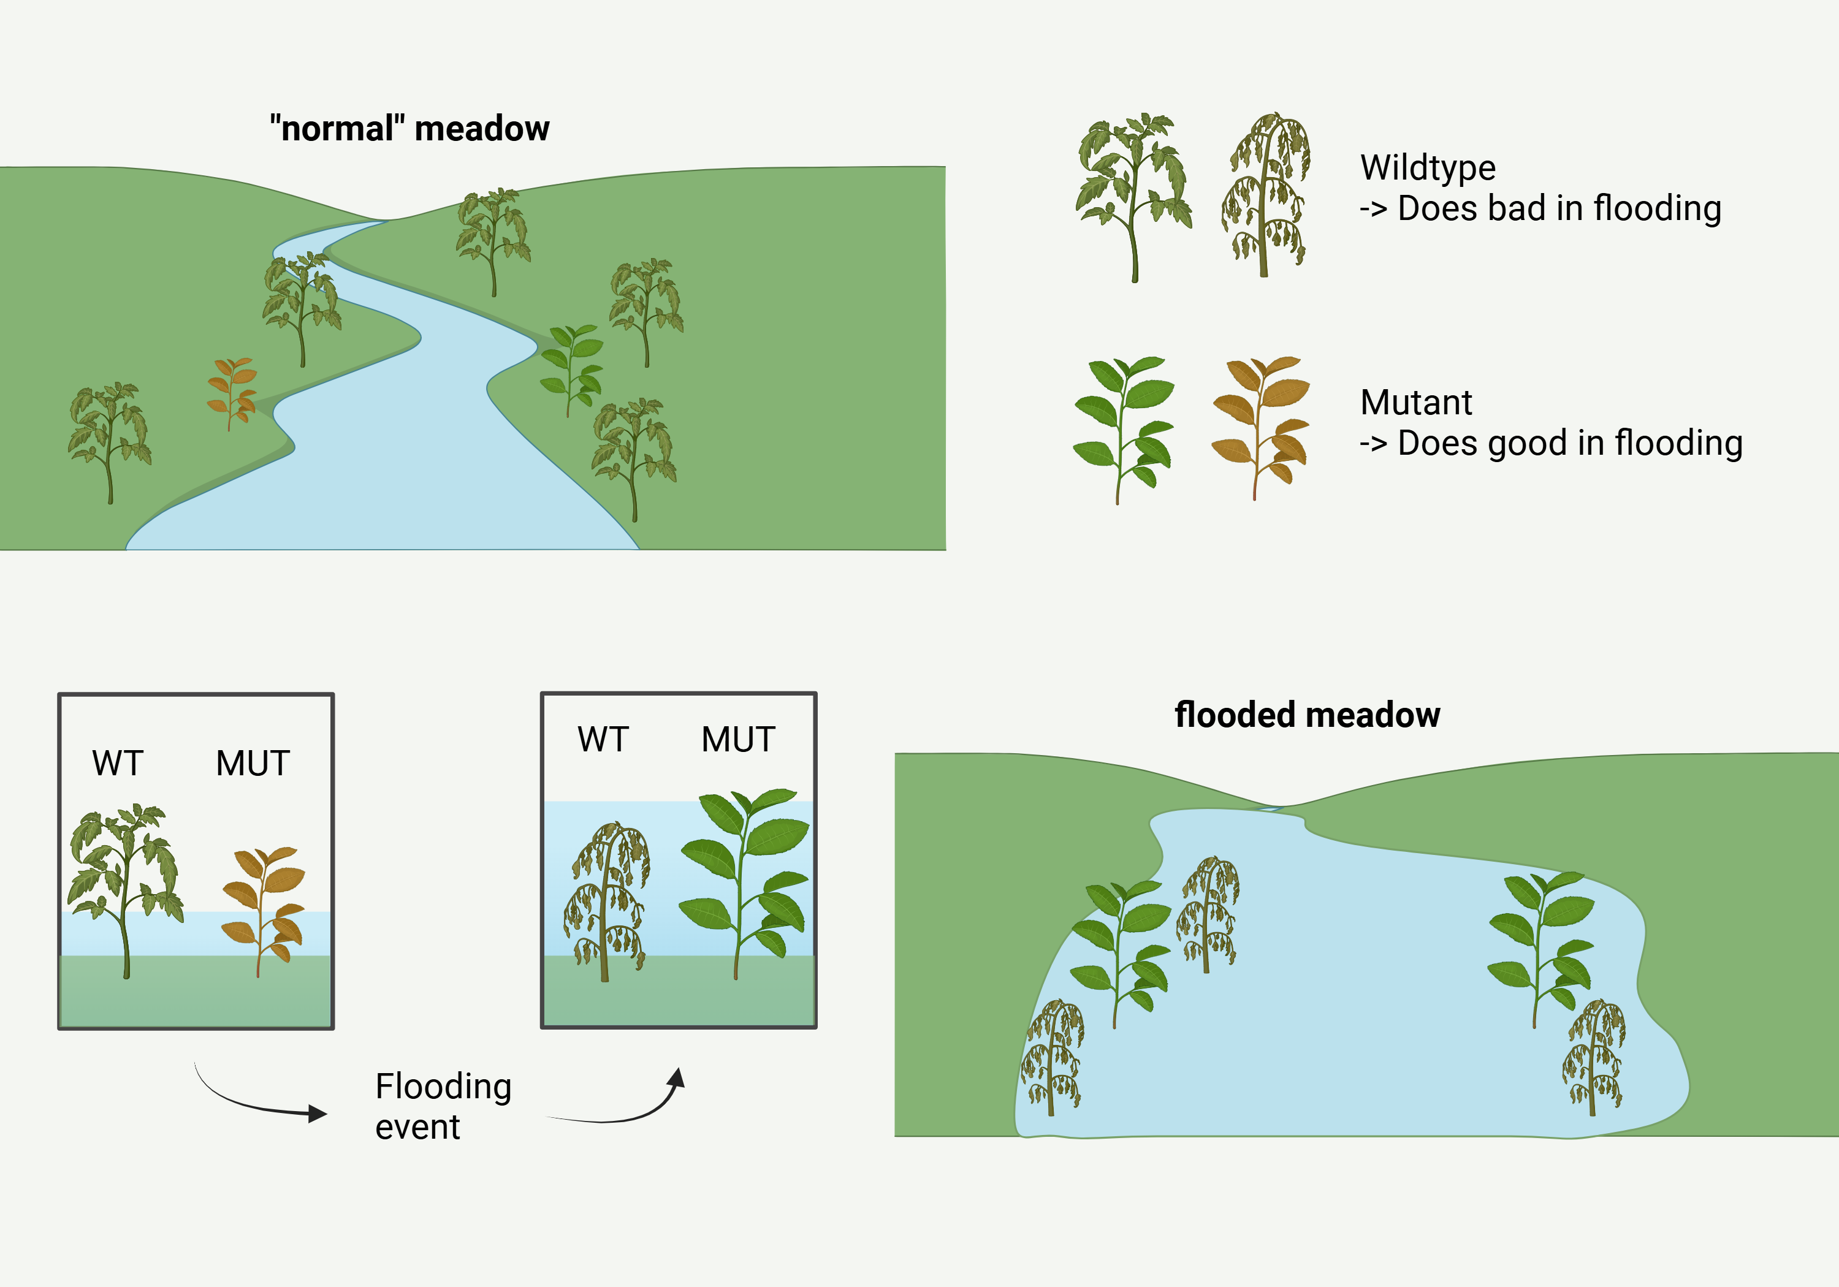
Our model
Simulation of several populations with different frequencies of flooding events
Parameters
Initial population size of WT and MUT → 1000; 0
Mutation rate → 0.001
Duration of flood→ 5 generations
Maximal Generation → 1000
Number of Replicates → 100
Stop-Conditions
Total Population = 0
Total Population = 1.5 * Initial Population WT
Variables
Population size of WT and MUT
Frequency of floodings → 1-10 generations pauses
Decay rate
Selection co-efficient
Decay rate WT: 0.03
Sel. Coeff. MUT: 0.05
Flood present
Depending on flooding
Decay rate WT: -0.02
Sel. Coeff. MUT: -0.015
No Flooding

Slide 7
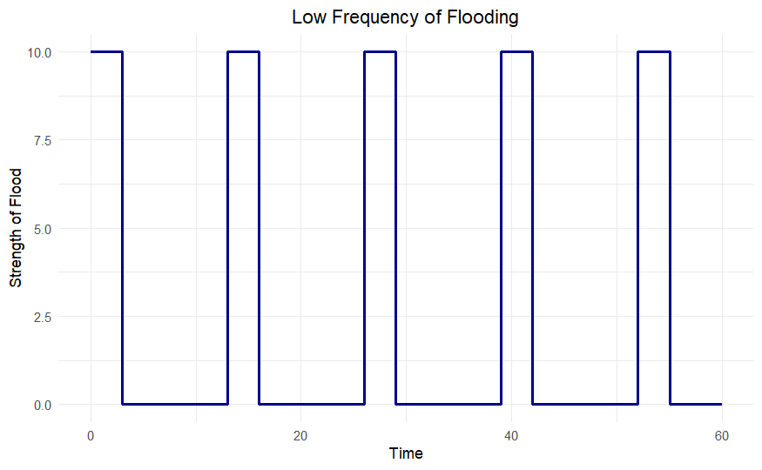
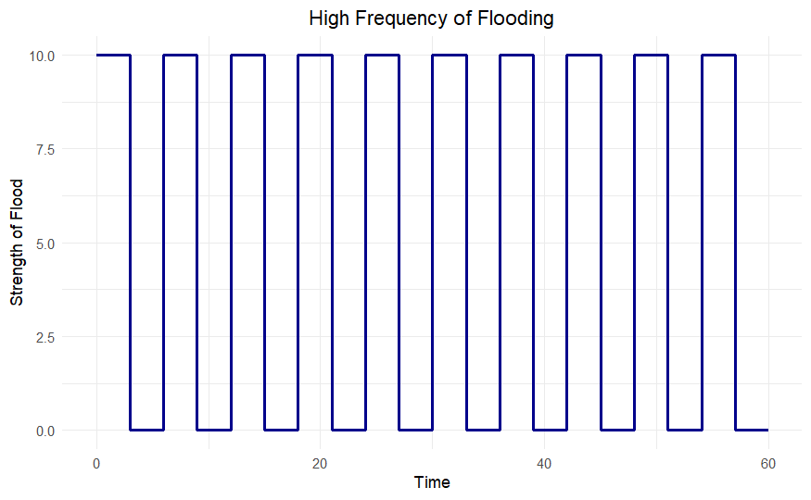
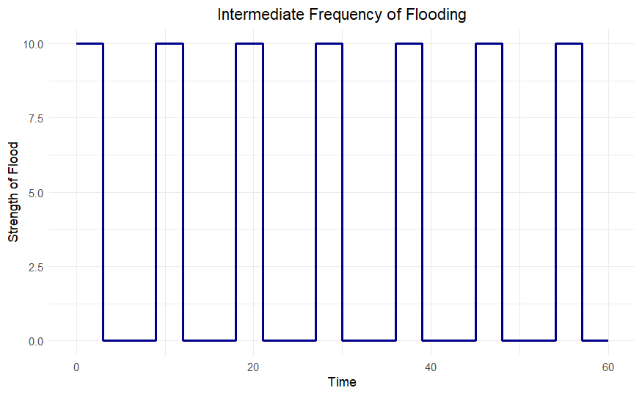
Our model – Flooding frequency
Pause between floodings
Duration of flooding

Slide 8
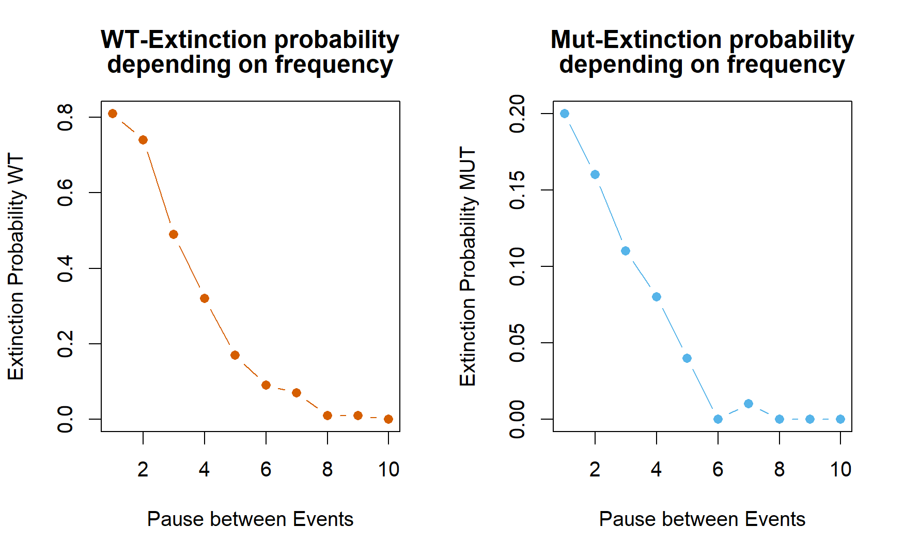
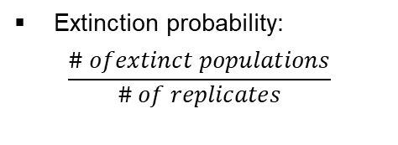
Extinction probabilities
Extinction probability:
$$\frac{\# ofextinct populations}{\# of replicates}$$

Slide 9
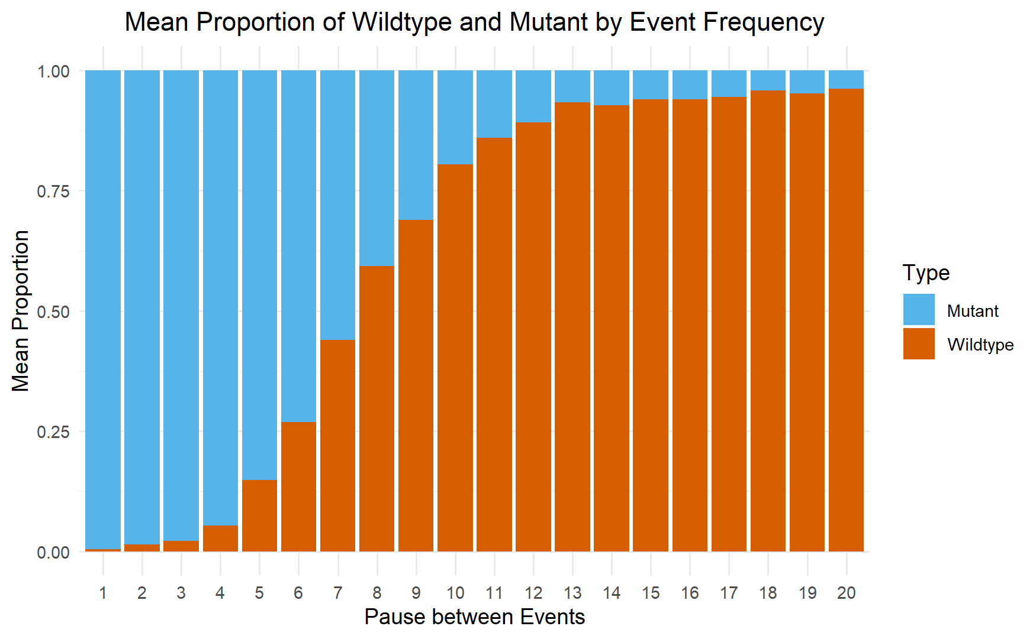
Changes in population composition
Pause btw. floods: 1 – 20 gen.
Notes:
Plateau at 98% WT and 2% MUT, if simulated for longer

Slide 10
Conclusions
High frequency of floods → WT goes extinct, Mut can take over
Low frequency of floods → WT persists, Mut cannot take over but still exists in the population
Mutations become more important in scenarios, where floods become more frequent
→ Floods can lead to extinction without adaption
Notes:
To think about it further in biological relevancy: having the mutant present (and maybe at higher proportions) increases ability to adapt to changes (show on slide 9)

Slide 11
Limitations
Pre-determined parameters and variables
Only one species with one mutation (→ two genotypes)
Haploid model
Mutation can not go extinct for itself
Notes:
Fixed duration of event
Appear regularly

Slide 12
Next steps
Adding new variables
Vary the strength of flooding
decay rate and / or sel. coeff.
Vary duration of flooding
Implement multiple mutation rates
Adding more species / making it diploid
Experiment in practice
Serve as a strain of thought
Notes:
Think about how increasing frequencies of drastic events have an effect on a population could be the basis for further conservation actions «and with that…»

Slide 13
Thank you for your attention!
Special thanks to all that helped develop this model

Slide 14
Intermediate Disturbance Hypothesis (IDH)
Species richness is maximized, when frequency of disturbances is at an intermediate
In our model:
More even distribution of WT & Mut at intermediate frequencies
But not directly a difference in genetic diversity

Slide 15
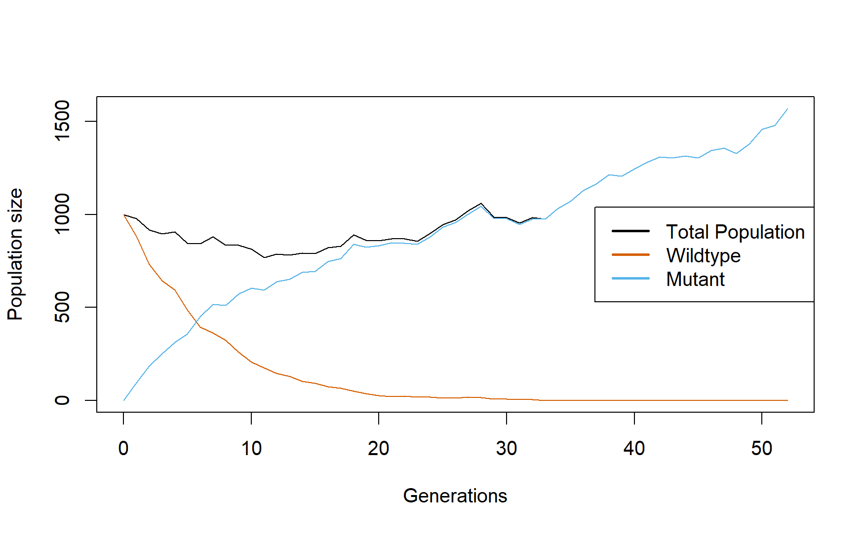
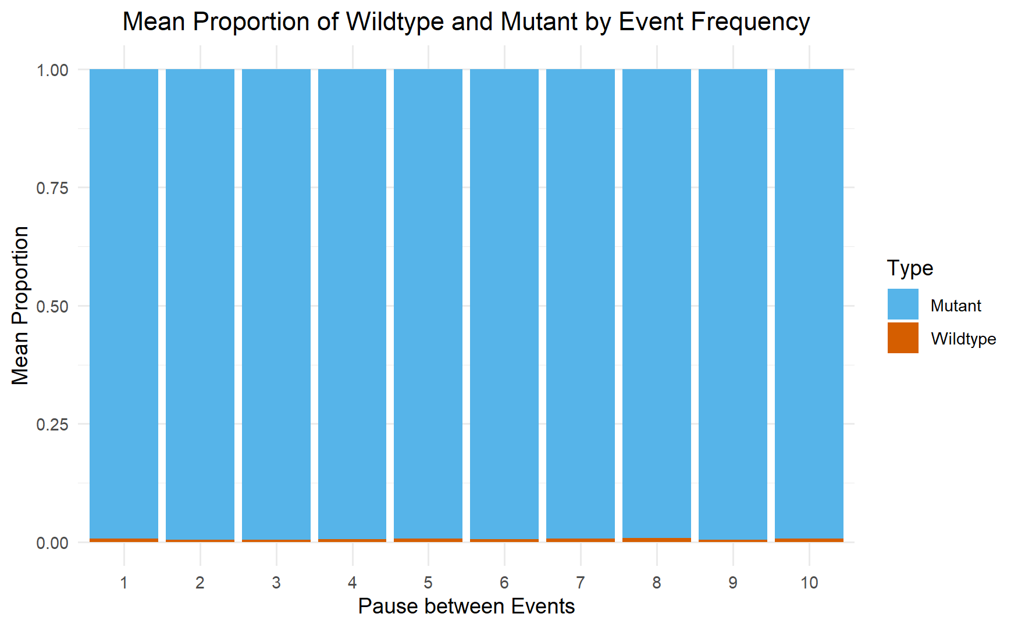
«Eternal flood»
t_event: 500

Slide 16
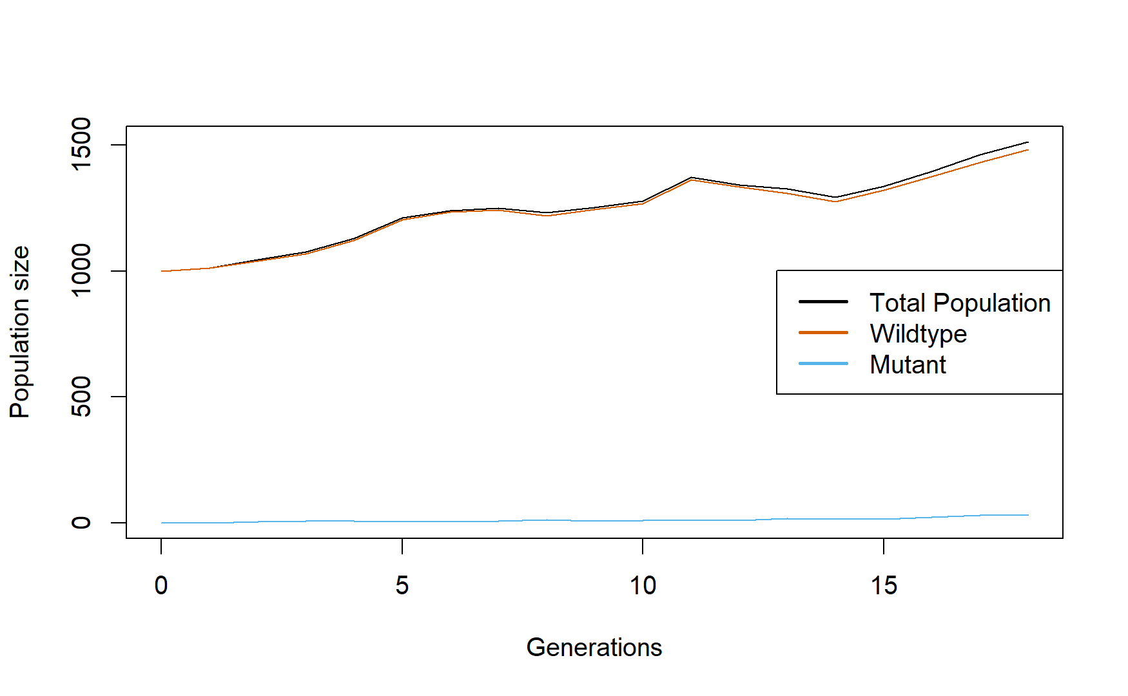
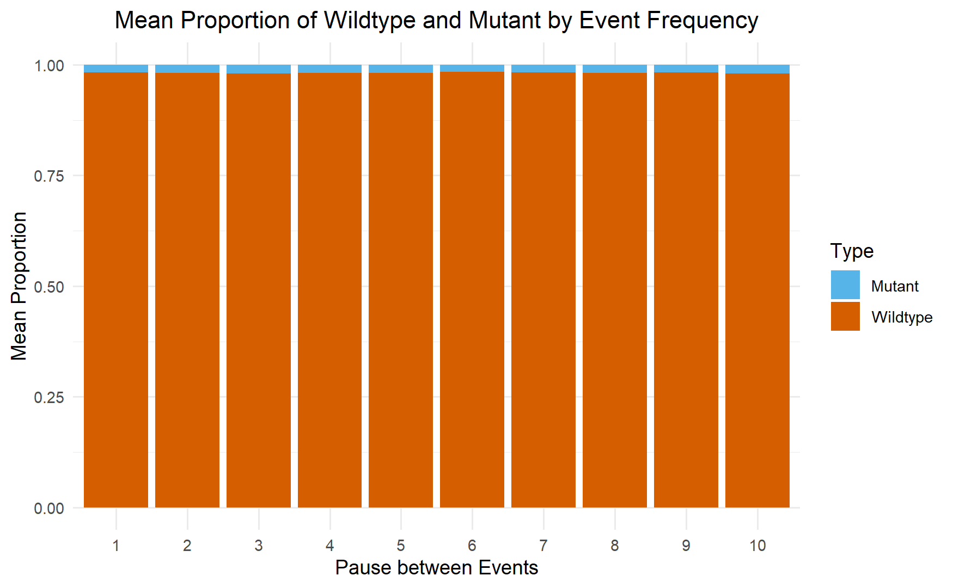
No flooding at all
t_pause: 500
t_event: 0

Slide 17
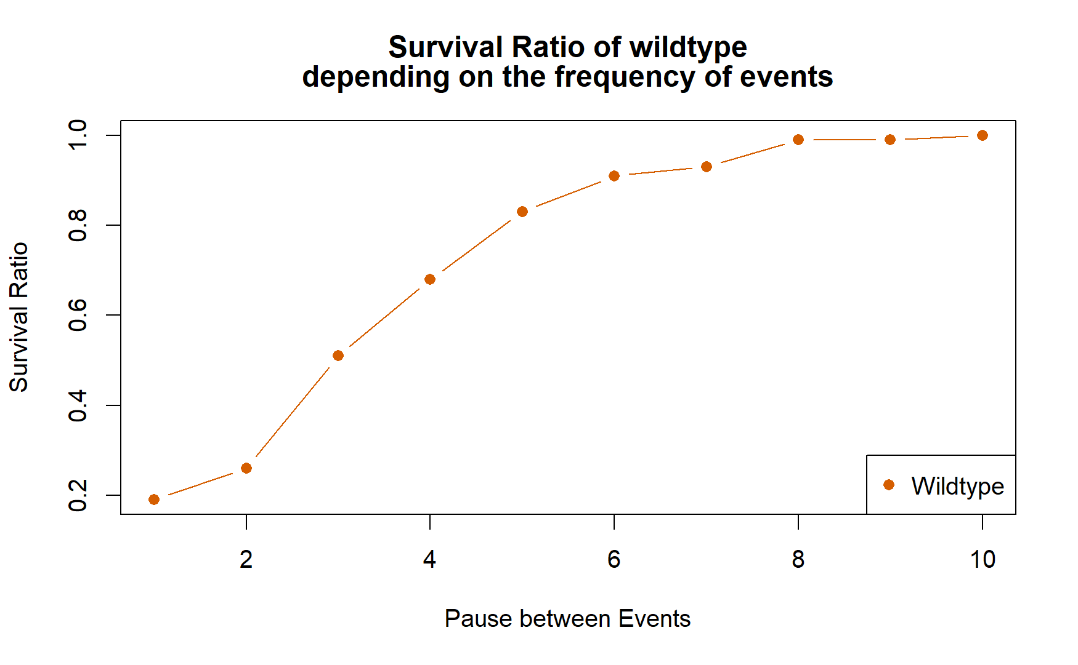

Slide 18
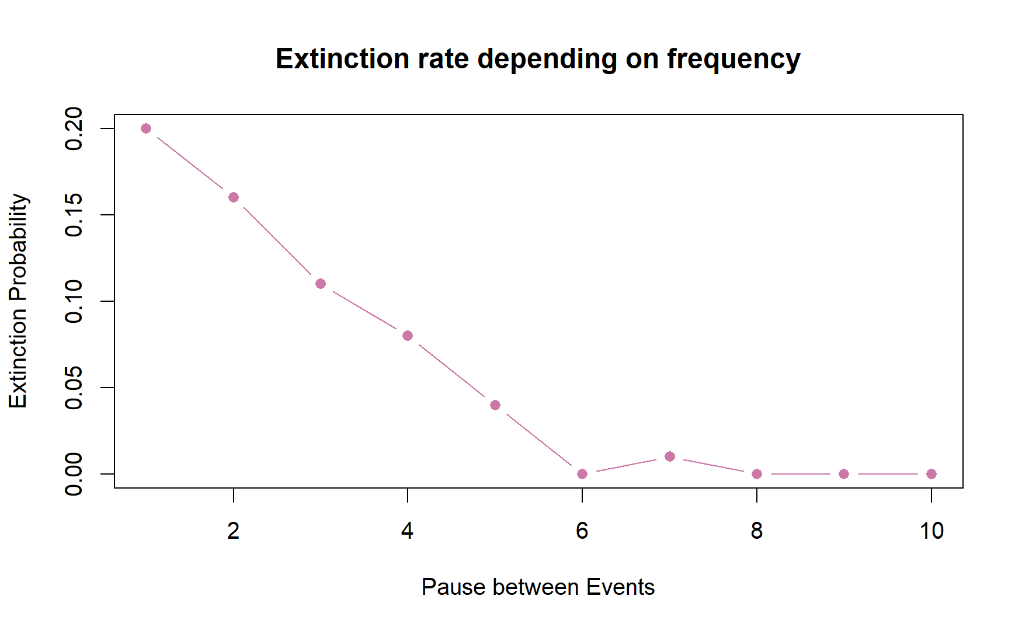

Slide 19
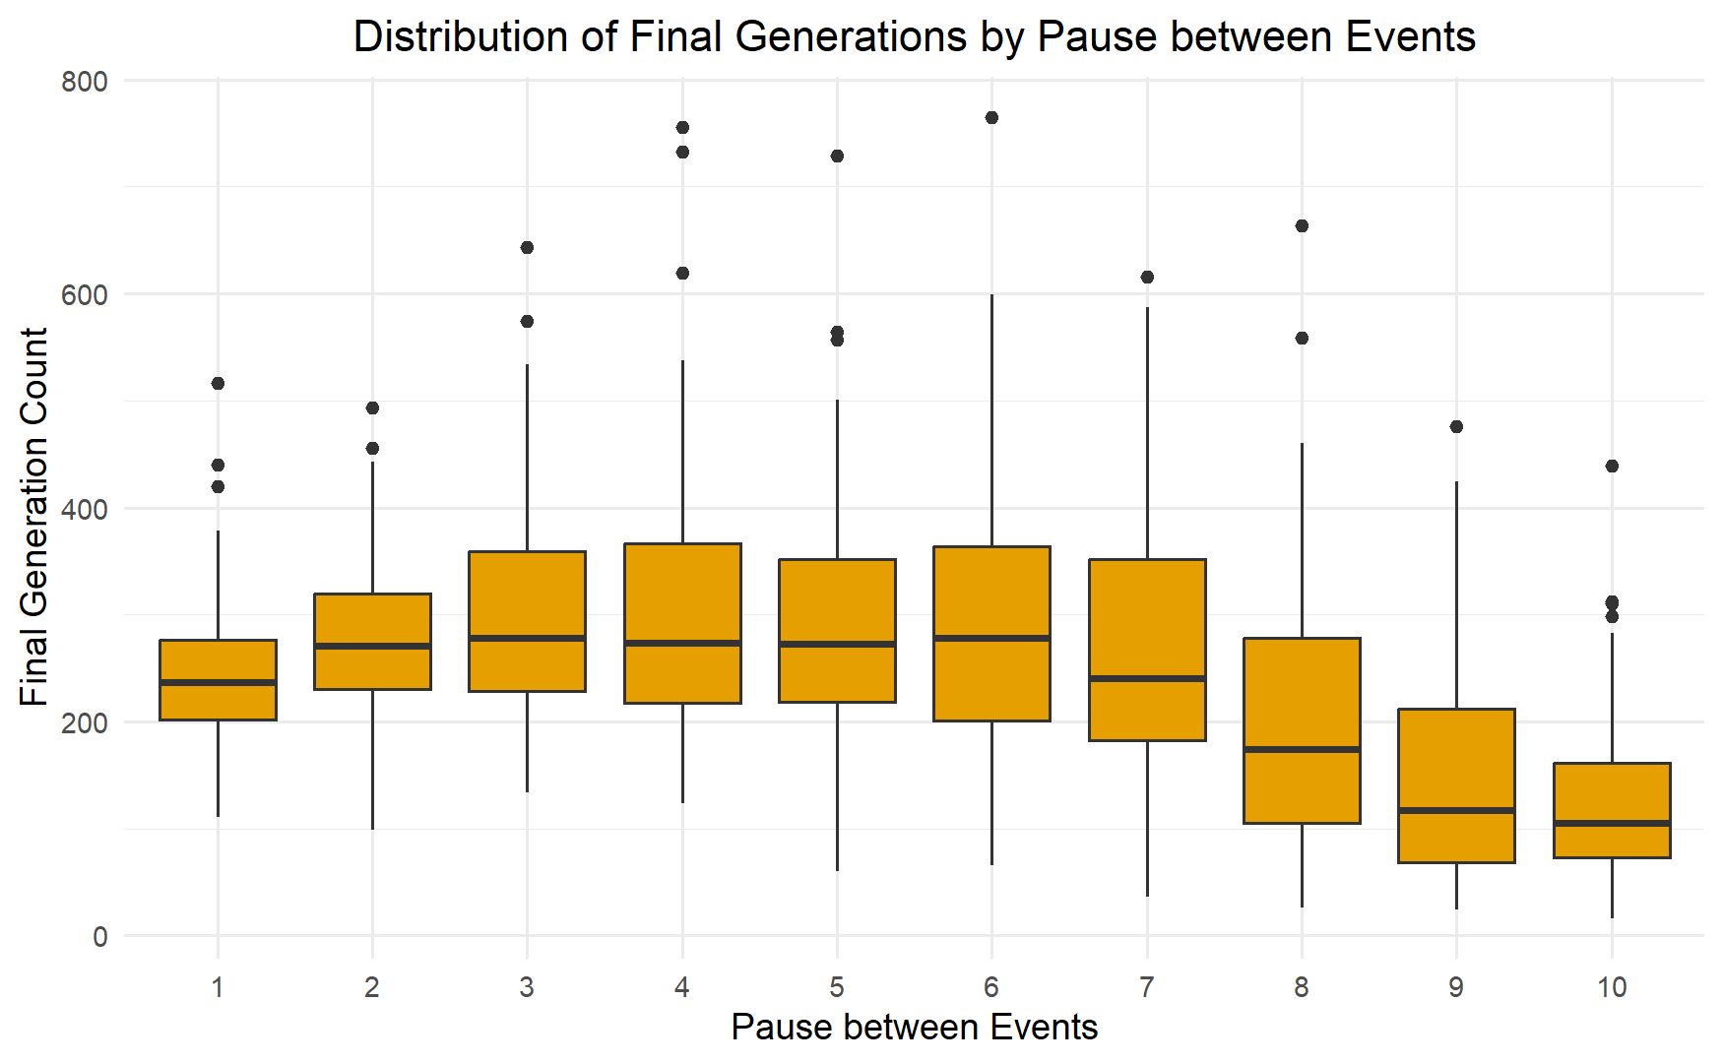

Slide 20
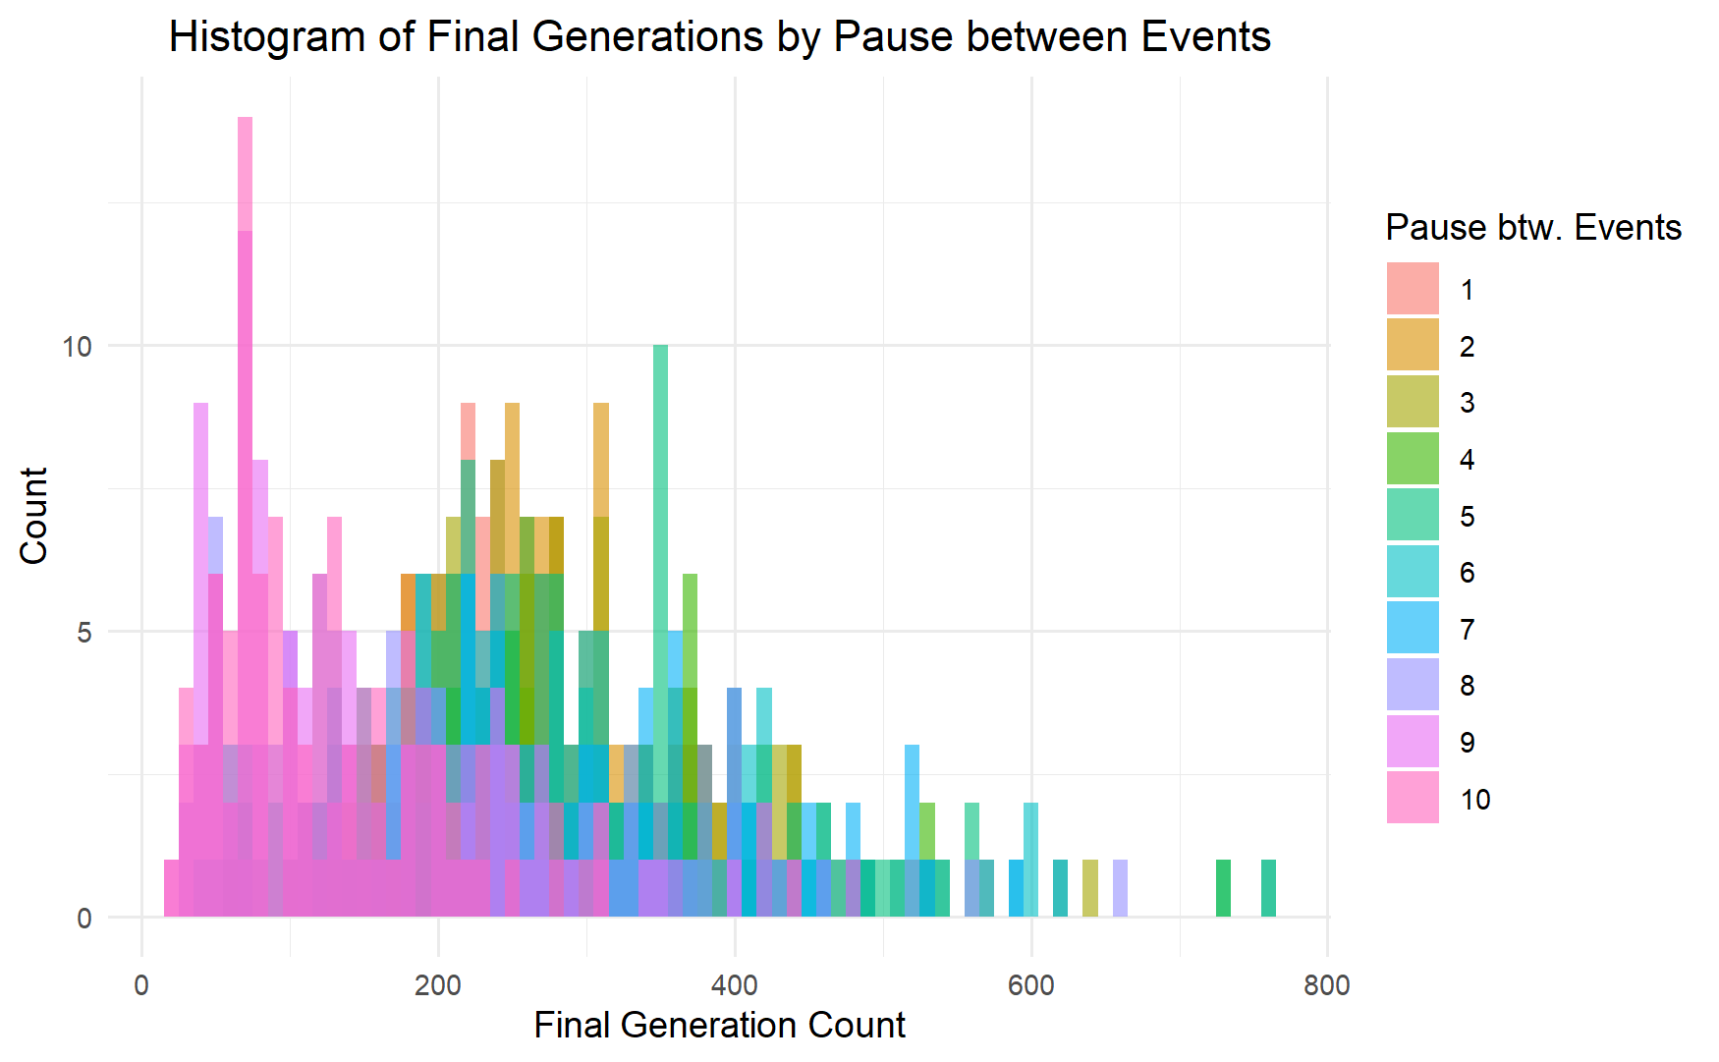

Slide 21
